Slide 1
MyCourse Scheduling
Istanbul Technical University
BLG 411E – Software Engineering
Fall 2019
Group 34

Slide 2
Contents
1. Introduction
2. Diagrams
3. Roles and Responsibilities
4. Technologies
5. Meetings
6. Goals and Results
7. Tests
8. Future plans

Slide 3

Introduction
Goal of our project is to provide a scheduling system to the members of our department.
Notes:
Açıkla

Slide 4
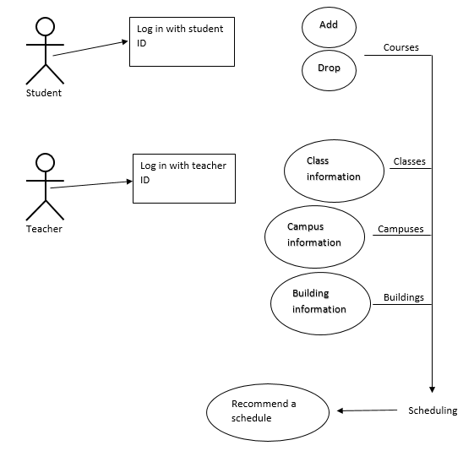
Diagrams
Use case diagram

Slide 5
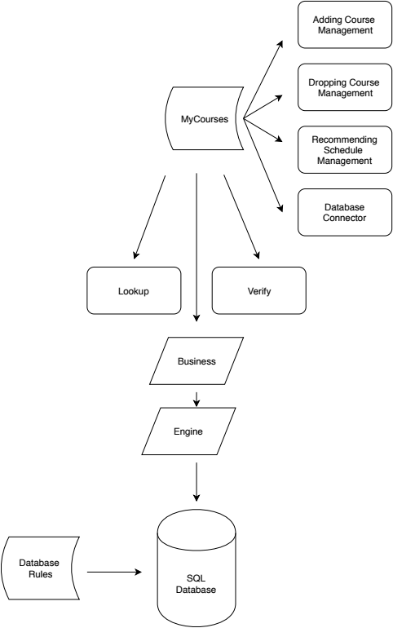
Diagrams
System architecture diagram

Slide 6
Team
Eray FELEK-150160081
Ayşe Sayın-040140037
İbrahim Öztürk-150160512
Serdar Yıldız-150160708
Hikmet Fatih Siyah-040160227

Slide 7
Technologies
Bootstrap
Angular 8
Java(Spring boot)
PostgreSQL
JIRA
Github
Webstorm - IntelliJ

Slide 8
Customer Meetings
We talked with our customer who is Bilge Süheyla Akkoca twice.
In our first meeting we have discussed the current stage of our project and informed what are we planning to do.

Slide 9
Customer Meetings
In our second meeting, we submitted our latest plan of implementation. Got feedback regarding to it.

Slide 10
Our meetIngs
Throughout the semester we have met for every homework and 3 times for discussing implementation and testing

Slide 11
Goals and Results
Features that we planned to have:
Recommending courses
Adding courses
Deleting courses
Modifying courses
Listing the courses for both students and teachers

Slide 12
Goals and Results
Registering lecture halls
Authentication for both students and teachers
Adding a list of courses that students are required to take
Automatic assignment of courses at once for all the students

Slide 13
Test Results
Big-bang approach and black-box testing techniques are used to test:
Sign-up
Sign-in
Different type of users
Weekly schedule page
Remove course
Add course

Slide 14
Future Works
Expanding our project to cover:
1. All faculties and departments
2. Irregular students.
3. Master students
4. Offering personalized scheduling according to transcript.
5. Scaling
6. Deploying to mobile platforms.

